Slide 1
Intraday Stock price prediction model
Team: SweetTooth
Prashant Bhat
Sreejith Kizhiyedath
Shinsmon Varghese

Slide 2
About the product
Select the Organization to view recent trends on stock market
Future predictions on their closing prices for Intraday trading
Availability to check accuracy of prediction of the past Intraday prediction
Prompts the user with recent tweets from the official twitter handles of the organizations which could help them decide better.

Slide 3
About the model used
We have used a simple LSTM model with following architecture
tanh
tanh
LSTM
LSTM
Preprocessing
Dropout
Dropout
MSE
Input
Raw Data from web/csv
Closing price prediction
Timeseries data

Slide 4
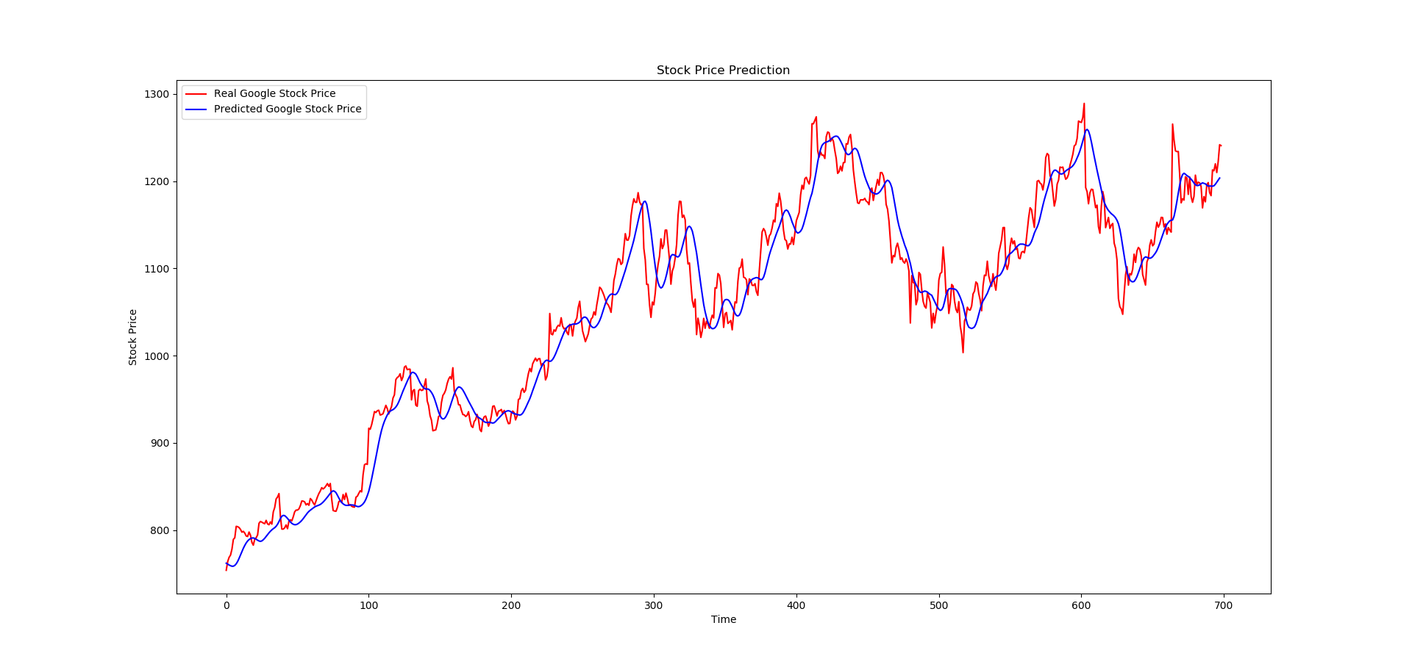
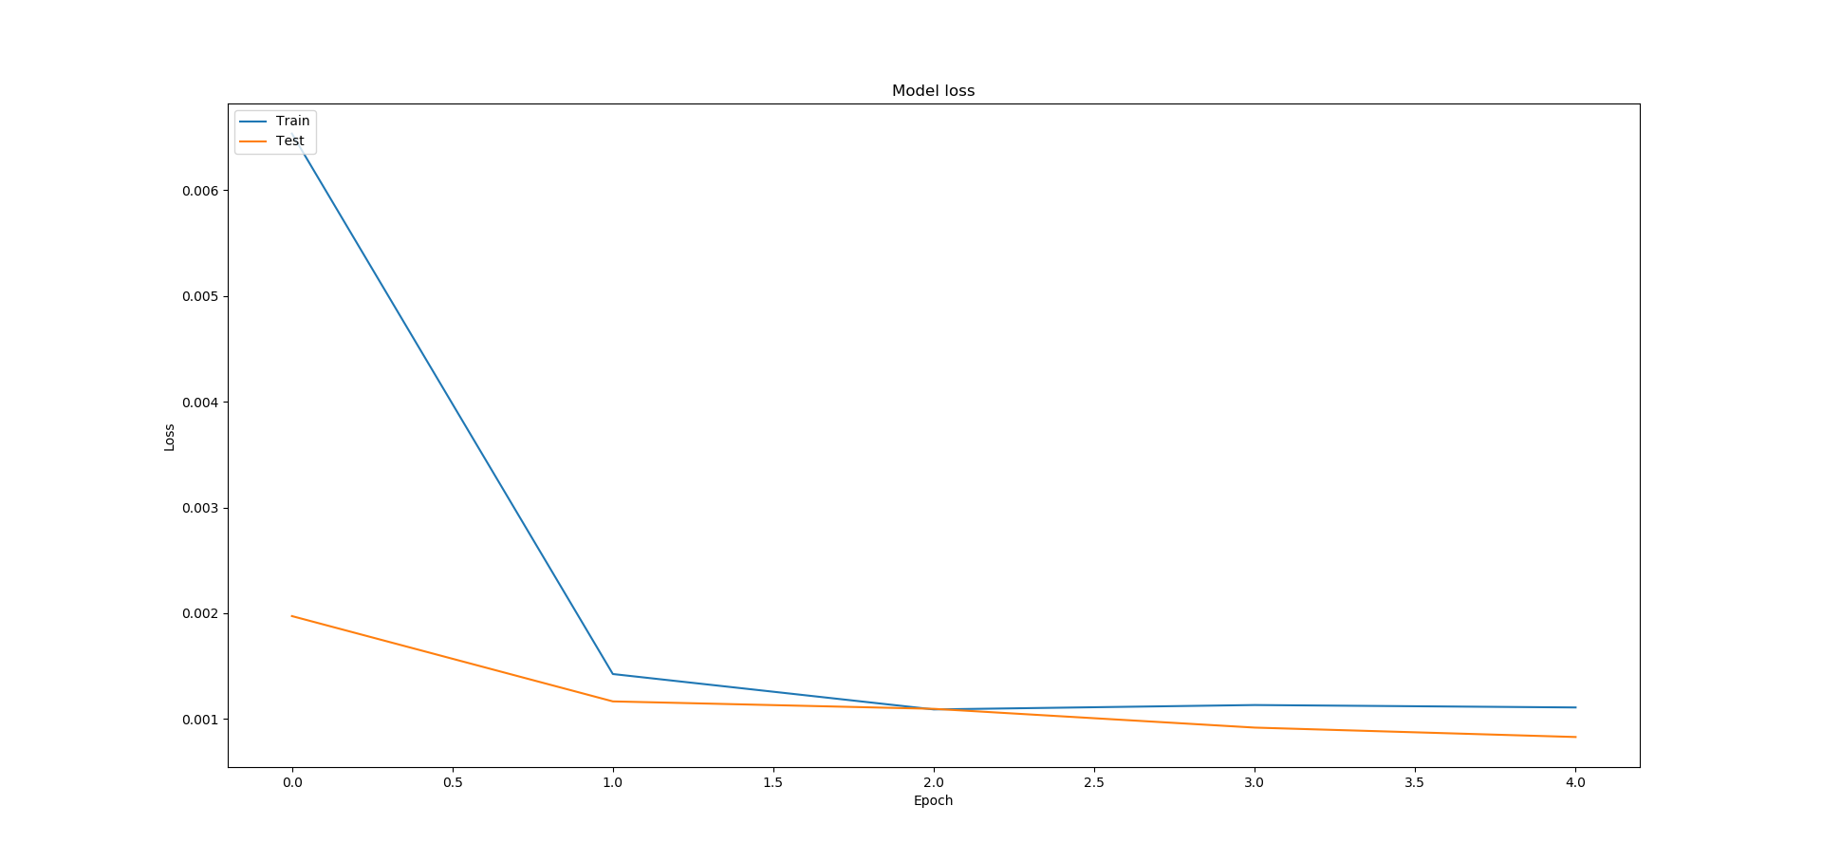
Training results
Real and Predicted trends
Training and Test Losses

Slide 5
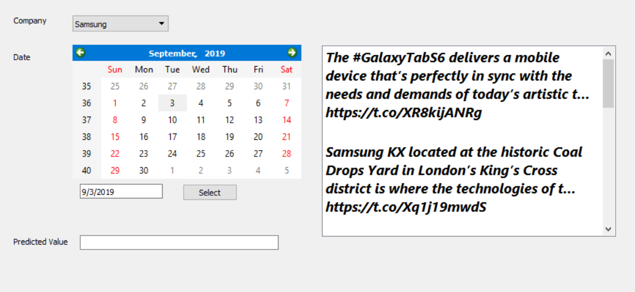
User Interface
The interface has facility to select the organization of choice
It displays the closing price and recent tweets from the handle.

Slide 6
Future Improvements
The tweets received can be converted to word vectors and with the NLP can be converted into feature vectors to further improve predictions for the stock prices for the respective organization.

